Slide 1
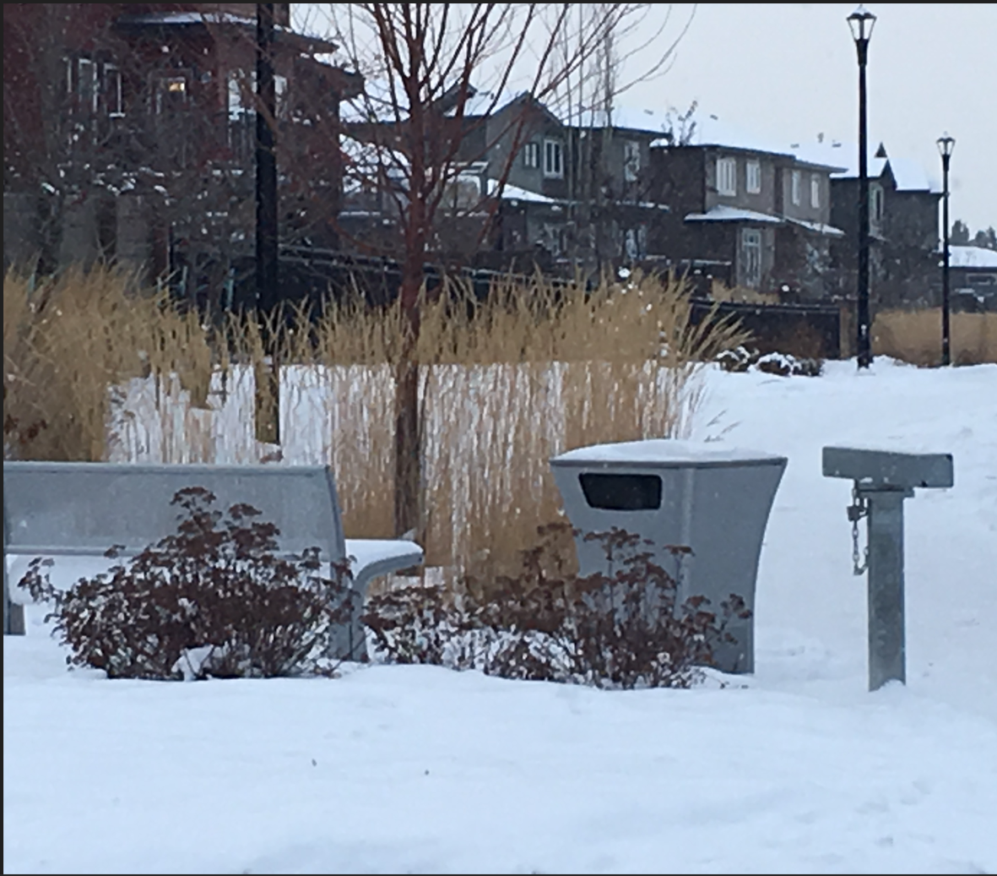
WELCOME TO one at Windermere
AND one HOMEOWNERS ASSOCIATION

Slide 2
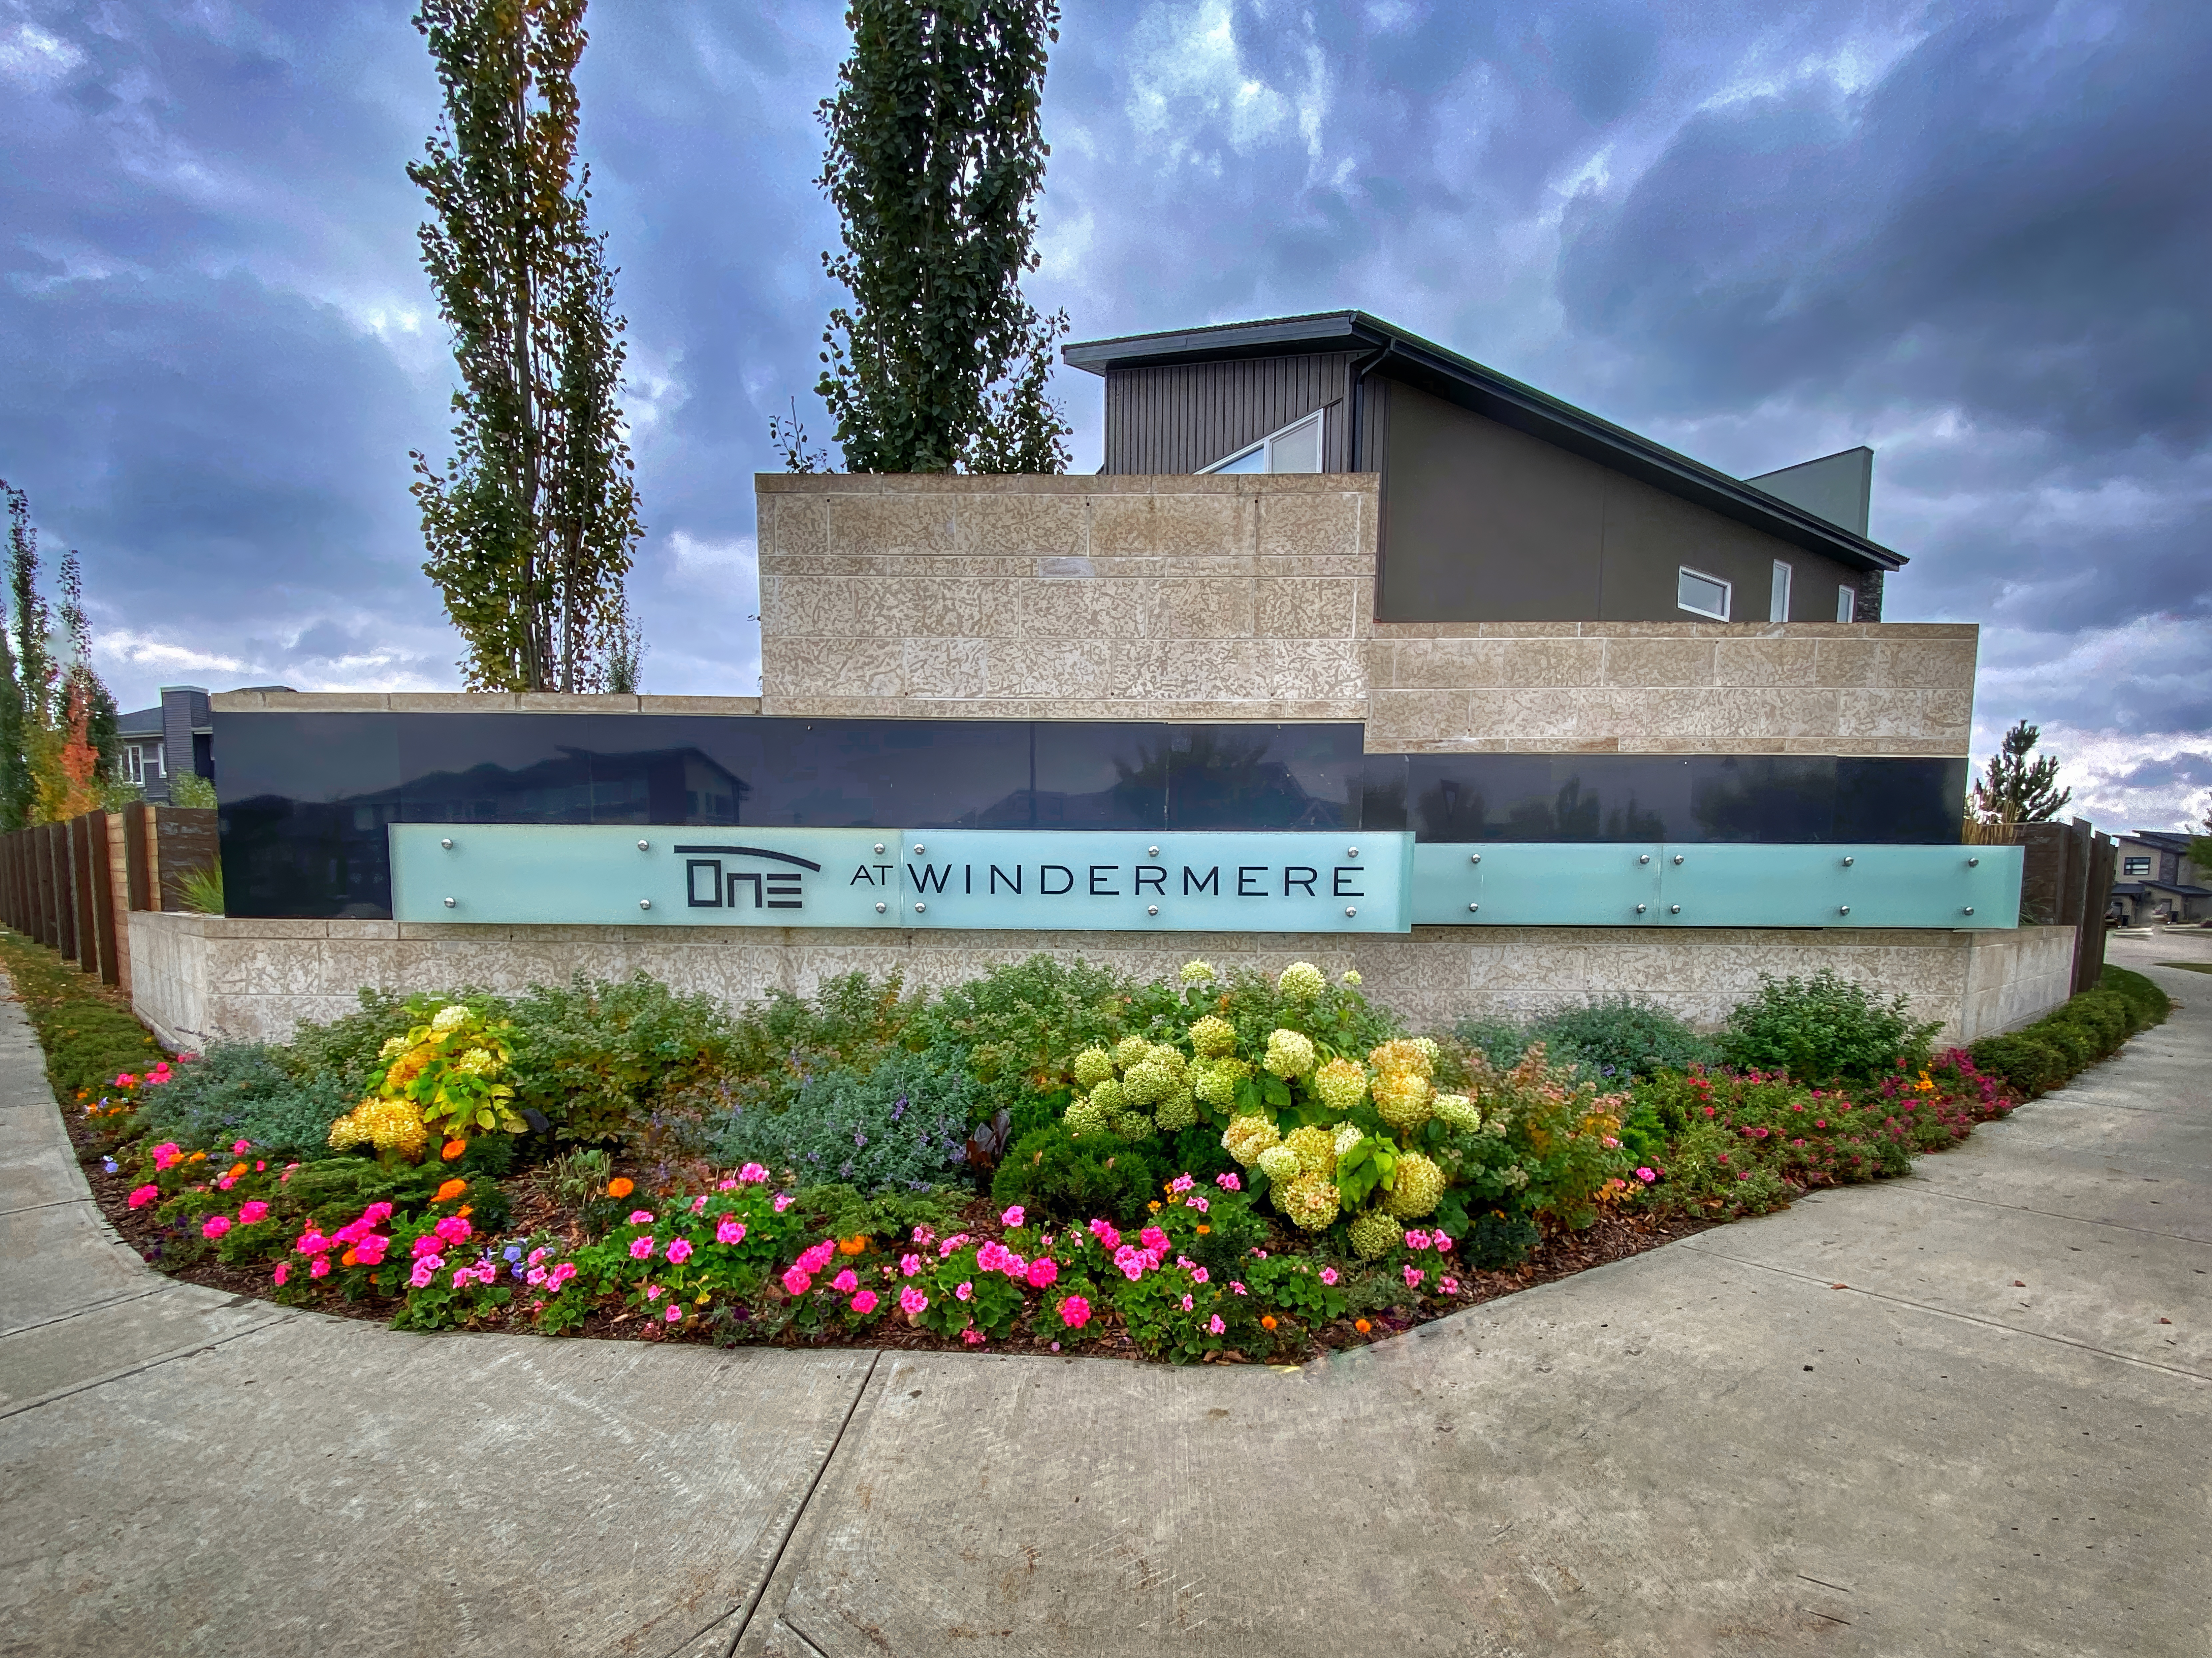
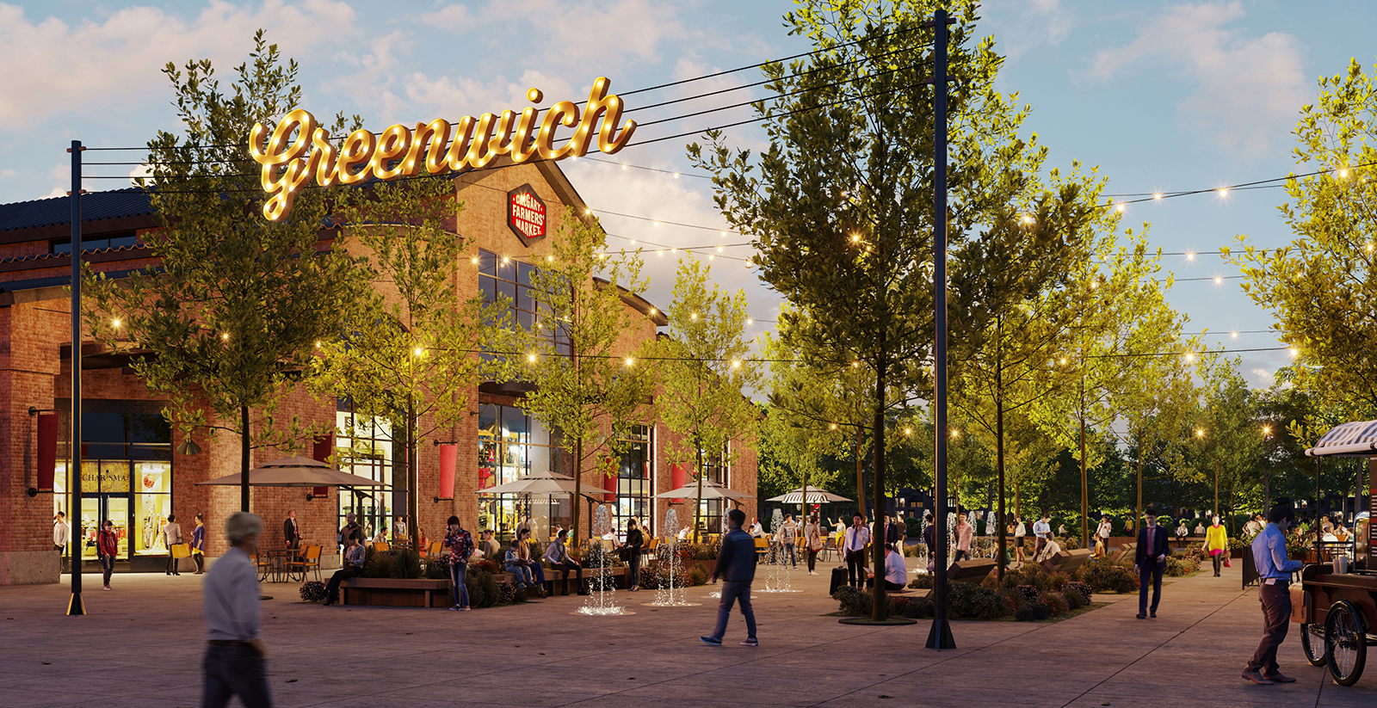
CONTENTS
2026 Budget Letter
2026 Budget Breakdown
Your Invoice and How to Pay
Important Dates
About Management Fees
Who to Contact

Slide 3
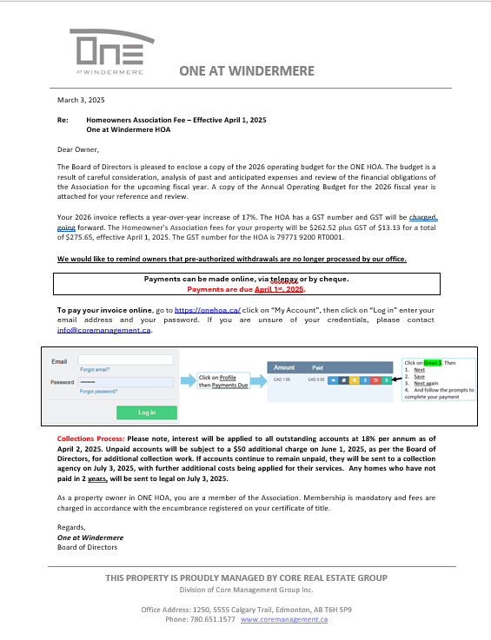
Owning property in
ONE at Windermere automatically makes you a member of the ONE Homeowners Association (HOA).
The Association manages, maintains and beautifies areas within the community for the benefit of the residents. This includes the community gardens, bushes, column identifiers, feature walls, enhanced lighting, as well as supplementing the City of Edmonton landscaping program to help maintain green spaces.
The ONE HOA is managed by the Board of Directors, that is comprised of members of the HOA who are elected at the Annual General Meeting (AGM) in September each year.
Each year the Board is tasked with reviewing the past year financials and using this data to create a budget for the upcoming year.
The budget letter outlines the amount of fees needed to meet the budget, how to pay your fees, what your fees pay for and more!

Slide 4
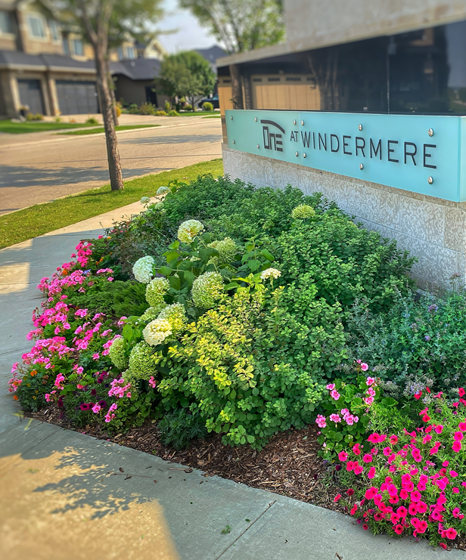
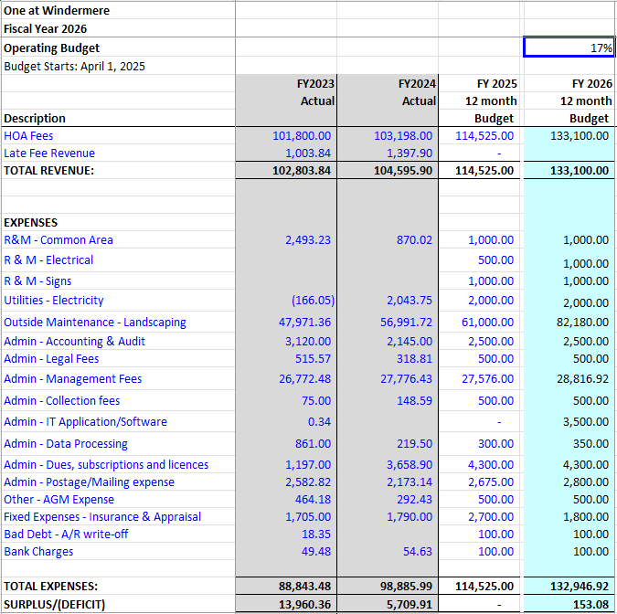
The budget summarizes the anticipated income and expenses for the Association for the upcoming year.
This budget is used to determine how much each owner will need to contribute to cover the costs.
For the 2026 Fiscal Year, fees will increase to 274.57 + GST.
Please note, the increase is due to additional work to maintain the landscaping to the standard of the community.

Slide 5
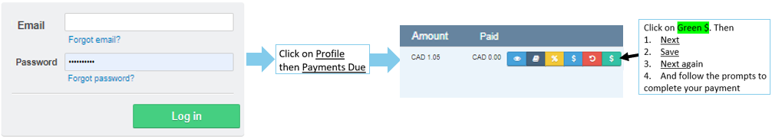
PAYING YOUR INVOICE
We offer three easy ways to pay your invoice:
  CHEQUE: Mail your cheque to ONE HOA
    Suite 1250, 5555 Calgary Trail NW. Edmonton, AB T6H 5P9
  ONLINE: You may login to your online account - See instructions below.
  TELEPAY: To pay by phone with your credit card call 587.393.3191 and follow the
    prompts, using the Access Code shown on your invoice.
To pay your invoice online, go to ONEHOA.ca and
click on “Log In”. Enter your email address and password and follow the process outlined below.
If you are unsure of your login credentials, please contact Core
If you need help paying your invoice or would like to receive a mailed copy, please contact Core
Call Core at 780-651-1577 or email info@coremanagement.ca
Payments are due April 1st of each year.
Please pay careful attention to pay on time. If payment is not received by April 2nd, you will be charged 18% per annum. Failure to pay will result in collection actions.

Slide 6
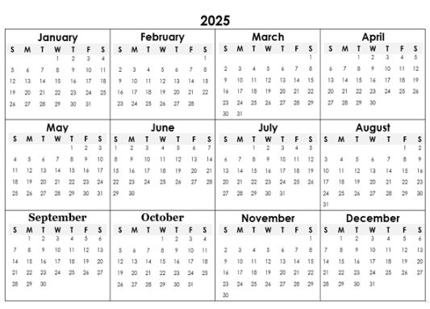
Important dates
  Collections Schedule for Unpaid Accounts
  February – Reminder to look for your invoice on March 3, 2025
  March 3, 2025 – Invoices sent to all owners for payment.
  April 1, 2025 – Payment is due in full.
  April 2 - Interest is applied to all outstanding accounts at (18% per annum).
  April 15 – Reminder that ONE HOA fees are overdue
  May 1 - Reminder that ONE HOA fees are overdue
  June 1 – Final reminder with $50 collection charge
  July 2 – All accounts in arrears are sent to collections. Any home more than 2 years in arrears is sent to legal counsel for collections.

Slide 7
About Management Fees
We are commonly asked what is included in the Management Fees. We understand that this is a large budget item.
The Management Fee is for the management of the day-to-day operations of the HOA on behalf of the Board of Directors.
The fees pay for the services of a professional property manager and includes, but is not limited to:
Working on behalf of the Board of Directors including establishing procedures and policies, annual budgets, communicating with members, facilitating board meetings, hiring and monitoring contractors, following through on recommendations and mandates as put forward by the board of directors, communicating and enforcing the Association’s governing documents, including Bylaws and Rules & Regulations.
Facilitating Annual General Meetings including arranging venues, producing AGM packages, delivering AGM packages via email or Canada Post, hosting the meeting, presenting the Association’s audited financials and facilitating elections, recording AGM minutes and managing the HOA’s annual return.
Managing maintenance items including obtaining quotes, obtaining board approval for expenditures, hiring and monitoring contractors and labourers, completing regular community site visits to ensure quality and contractor compliance.
Managing membership requirements including verifying and updating owner and property information, providing information to owners and realtors during property sale transactions, educating owners on Homeowner’s Associations and the governing documents, providing direction to owners regarding expectations and responsibilities, managing owner disputes, provide IT support for owners to access their online profiles, referring owners to appropriate agencies outside of the HOA, such as EPCOR or the City of Edmonton as appropriate.
Managing communications with owners, contractors and the Board of Directors including receiving, responding, recording and storing owner questions, concerns and complaints, liaising between owners and the board of directors, receiving and responding to emails, phone calls, letters, visitors, managing financial aspects of the Association including annual invoicing and communications, managing accounts receivable and collections, receiving payments, paying invoices, data entry, compiling monthly financial statements, financial reporting, working with auditors to complete annual audits.

Slide 8

Important Contact info
ONE HOA is proudly managed by
Core Real Estate Group
1250, 5555 Calgary Trail NW
Edmonton, Alberta T6H 5P9
Please contact our friendly staff for questions relating to:
Association budget and fees
Help with paying your fees
Maintenance concerns, such as landscaping, signage, etc.
Information about the Annual General Meeting
Volunteer opportunities
Architectural Guidelines or Association Bylaws
Email: info@coremanagement.ca
Phone: 780.651.1577
For more information on ONE HOA, please visit: ONEHOA.ca

Slide 9
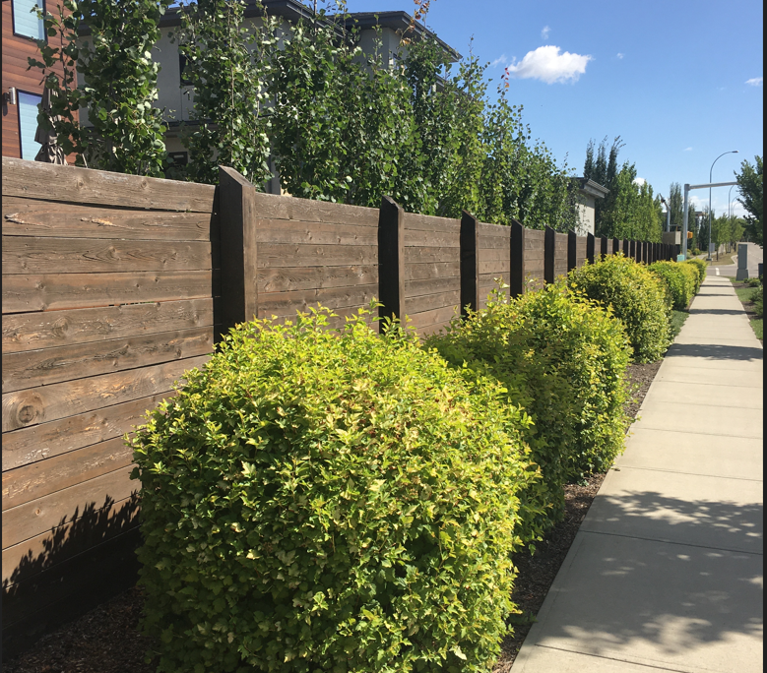

THANK YOU

